Slide 1
Strengthening Civil Society and Community Capacity
to Respond to HIV/AIDS
Jennifer Whatley, Blanka Homolova
SIT Symposium, Brattleboro VT
August 10, 2010

Slide 2
HIV/AIDS Pandemic
Complex socio-economic issue, not just a health problem
Requires complex, multi-sectoral approach
Local capacity/country ownership – a factor of success (SUSTAINABILITY!)
New Trends: INGOs in the role of TA Providers and Mentors
WL as a capacity-building institution is perfectly positioned to build on expertise in variety of areas to provide partners with skills and tools to design and implement suitable and effective interventions

Slide 3
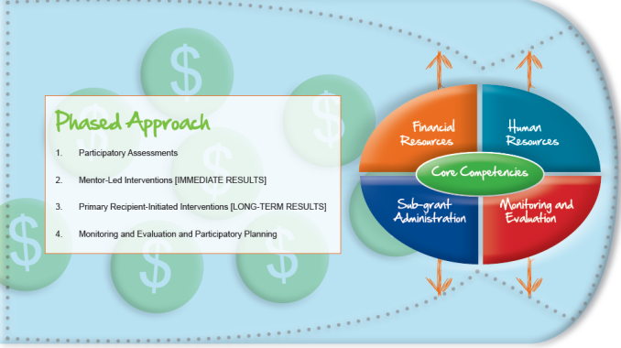
IDEP HIV/AIDS PORTFOLIO
ILLUSTRATIVE EXAMPLES
International Leadership and Visitors Exchange Program topics included: HIV Prevention
OVC Care and Support Interventions
STRUCTURAL INTERVENTIONS
Civil Society Strengthening
VEP
SCOPSO
Education
HIV/AIDS
CSSP Angola
CS&G
CBS
BEHAVIORAL AND STRUCTURAL PREVENTION INTERVENTIONS
[ e.g. Prevention Project in Ethiopia]
GSM
GSM Program Ethiopia
Community Connections
Past Programs dealt with issues of:
Stigma and Discrimination
Healthy Behaviors
Substance Abuse (Youth-focused)
Infection Control and Blood Safety …

Slide 4
The Capacity Issue …
Insufficient financial management capacity of local organizations has been a major hindrance in disbursement of funds (and a major criticism of GF ATM) creating a “bottleneck” problem.
THE NEED:
Immediate support to create adequate systems and human resource capacity to manage funds and provide effective oversight over potential sub-grantees.

Slide 5
Participatory Institutional Analysis Instrument (PIAI)
“The PIAI challenges us to make changes that are not always easy to confront.”
-- Deputy Director, Angolan CSO

Slide 6
PIAI is used to …
Analyze the organizational capacity of a CSO
Prioritize areas for capacity building
Guide action planning
Measure change over time and across organizations
Educate CSO leadership and staff about organizational development concepts

Slide 7
How does the NGO manage internal conflict? How is the work divided?
HUMAN RESOURCES
Staff Roles
Task Management
Staff Development
Salary Administration
Team Development
Conflict Resolution
Does the NGO have adequate coordination?
How is the NGO funded? How does it manage those funds?
OPERATIONS & MANAGEMENT SYSTEMS
Management of Information
Administration
Communications
Program Development and Implementation
FINANCIAL RESOURCES
Accounting
Budgeting
Financial Controls
Audit/External Financial Review
Resource Base
Is someone keeping the boxes in balance?
GOVERNANCE
Board of Directors or
Other Governing Body
Mission
Legal Status
Constituency
Leadership
How does the NGO manage across boundaries?
What business in the NGO in? How well does it do it?
EXTERNAL RELATIONS AND ADVOCACY
Public Relations
Government Collaboration
NGO Collaboration
Advocacy
Mobilization of Resources
SERVICE DELIVERY
Sectoral Expertise
Community Ownership
Impact Assessment
EXTERNAL ENVIRONMENT
What constraints and demands does it impose?

Slide 8
Process ...
WL staff or consultants act as a facilitators
Participatory process involving CSO leadership and staff
Facilitator guides CSOs to rate their own capacity
CSO analyzed across up to six competency areas and up to 28 sub-categories and 95 sub-sub-categories

Slide 9
PIAI Stages of Development
Mature (4)
Consolidating (3)
Developing (2)
Start-Up (1)
Start-up: Short history, limited organizational and staff experience managing complex multi-year grant funded projects.
Developing: Characterized by rapid growth, high energy and much activity. Much time is spent developing the service delivery side of the organization. Usually behind in its administrative functions because of the rapid growth rate. High level of learning necessitated by the rapid growth. A mature organization can move into this mode when it attempts a new area of focus or enters a new geographical area.
Consolidating: Characterized by continued high quality service delivery and intensified focus on other areas of organizational development. It is a time when the learnings of the developing phase are incorporated into the organization.
Mature: The organization is fully functional in all competency areas.

Slide 10
PIAI Matrix Excerpt Financial Resources
Sub-Category | Start-up Stage | Developing Stage | Consolidating Stage | Mature Stage
Accounting
Existence of accounting procedures | No accounting manual either formal or informal. | Basic financial recording system in place. | Accounting procedures in place; periodic moves to adjust/edit/organize procedures. Full documentation not always followed. | Financial reports and data system well documented enough to provide sense of NGO’s financial health.
Timeliness & accuracy of accounting | Financial reports incomplete, difficult to understand, can be fictional. Organization needs to be prodded to produce them. | Financial reports clearer but still incomplete, with errors. Usually late. | Financial reports clearer and more complete, even as portfolio becomes more complex. Usually on time. | Financial reports clear and complete, even as portfolio becomes more complex. Reports are always timely.
Contribution of financial reports to planning process | None yet; formats are ad hoc or based on donor requirements. | Financial reports formats tend to be skewed toward presenting an optimistic picture rather than reflecting reality. | Reports are regular, but not always timed to contribute to planning processes. | Reports are always high quality, and feed back into financial planning process.

Slide 12
PIAI in Ethiopia: GSM Program

Slide 13
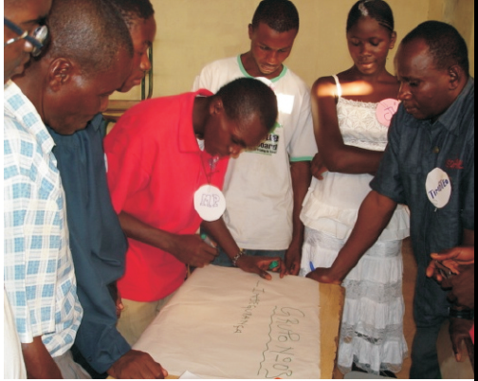
PIAI in Angola: CSSP
Used to analyze capacity of 50 CSOs working on HIV/AIDS, education, or land rights issues
Adapted for Angolan context (1-5 scale)
Repeated annually to monitor progress
Basis for capacity building action plan including training, mentoring, peer learning

Slide 14
A few CSSP results to date
Baseline PIAI showed 78% at level 1, 22% at level 2. None at levels 3-5
Latest PIAI shows 30% at level 1, 54% at level 2, 16% at level 3. None at level 4 or 5
54% have more than tripled their annual budgets
7 CSOs can manage funds up to US$500,000.
11 CSOs can manage funds up to US$250,000.

Slide 15
Thank You

