Slide 1
Hands-on Approach to Learning Art and Culture
World Learning/SIT August 2010 Symposium
Souleye Diallo, Academic Director
Senegal: National Identity and the Arts

Slide 2
Agenda
Introduction to the hands-on approach
Workshop examples
Student performance and conclusion

Slide 3
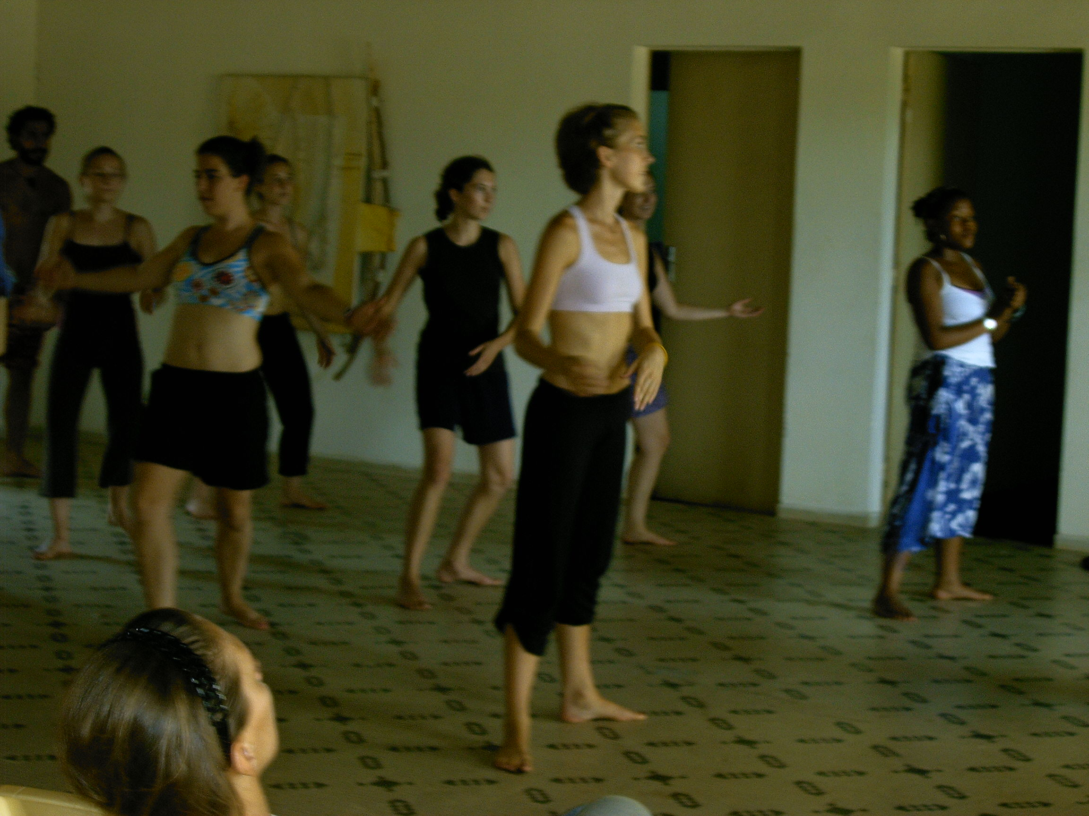
Introduction
Everything in the arts is communal and participatory as the stage in the African context is different.
There is always an exchange between performers and the audience.
Students learn from the artists and immediately share the art form with family, friends and the host community.

Slide 4
Hands-on learning
Requires students to become active participants, not passive learners
Involves materials-centered and manipulative activities that focus on creation (of artwork, music, dance or even food)

Slide 5
Hands-on learning
The hands-on approach is literally just that. It involves physical contact and appropriate touch between the student and the instructor.
The student is first guided and then “set free” to explore and create.
Notes:
The instructor often manipulates the student’s hands in order to teach a certain skill. The student repeats this movement until she can do it on her own.

Slide 6
Hands-on learning
Takes place in various settings:
Classroom
Under a big Baobab tree
On the lawn
At the beach
The market
An art studio

Slide 7
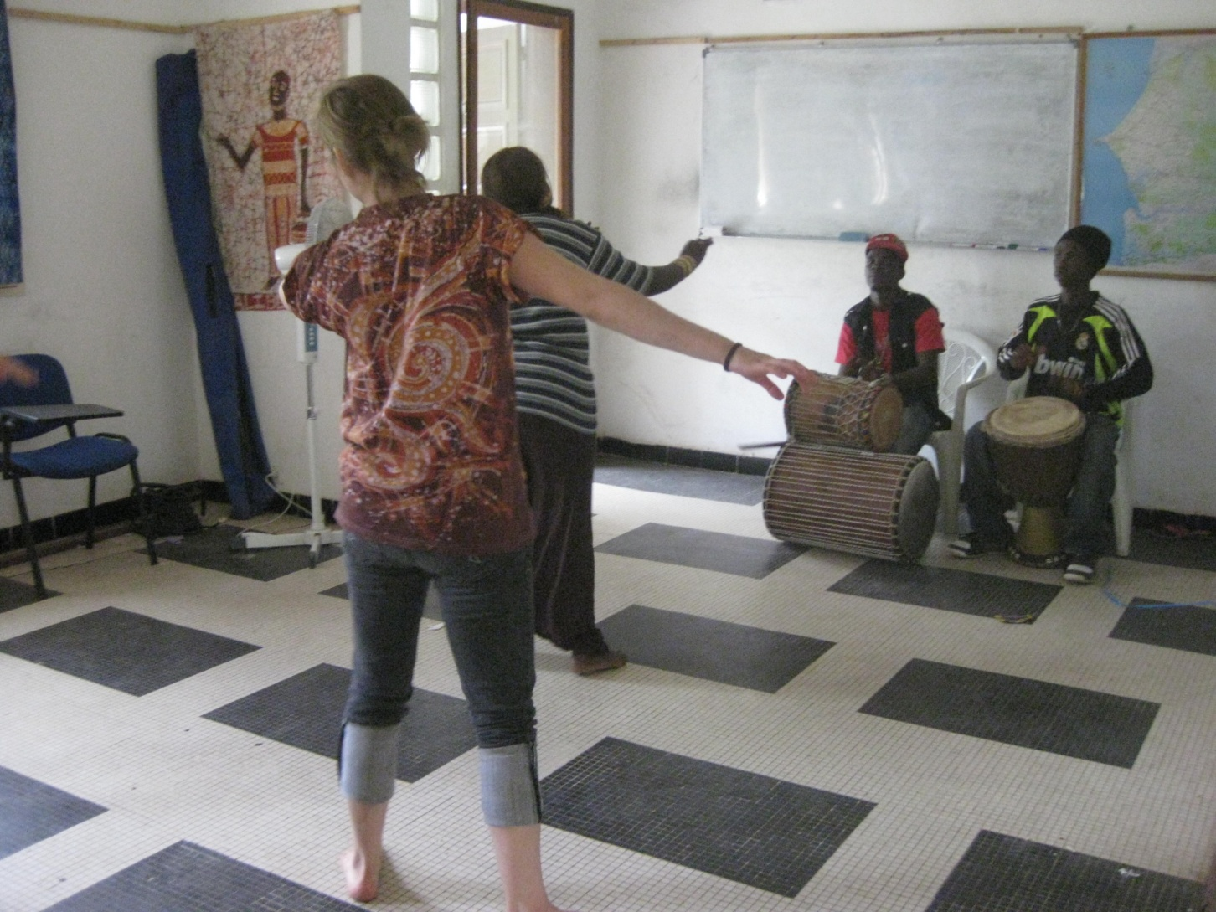
Music and Dance Workshops
All students participate in an introduction to djembe drumming and traditional West African dance
They then choose between the following options:
Djembe (advanced)
Tama or “talking drum”
Kora
Dance (advanced)

Slide 8
Djembe
“I can’t think of a better way to be introduced to the djembe than to start playing right away.”

Slide 9
Tama, the “talking drum”
“Aziz is great and clearly loves what he does. Our lessons were casual, fun and based on our own creativity.”

Slide 10
Kora
“Fun! I was able to have intimate instruction. I liked that you didn’t need to have a musical background.”

Slide 11
Dance
“It’s amazing that we learned that whole dance without any words to help us! Show and learn worked really well!”

Slide 12
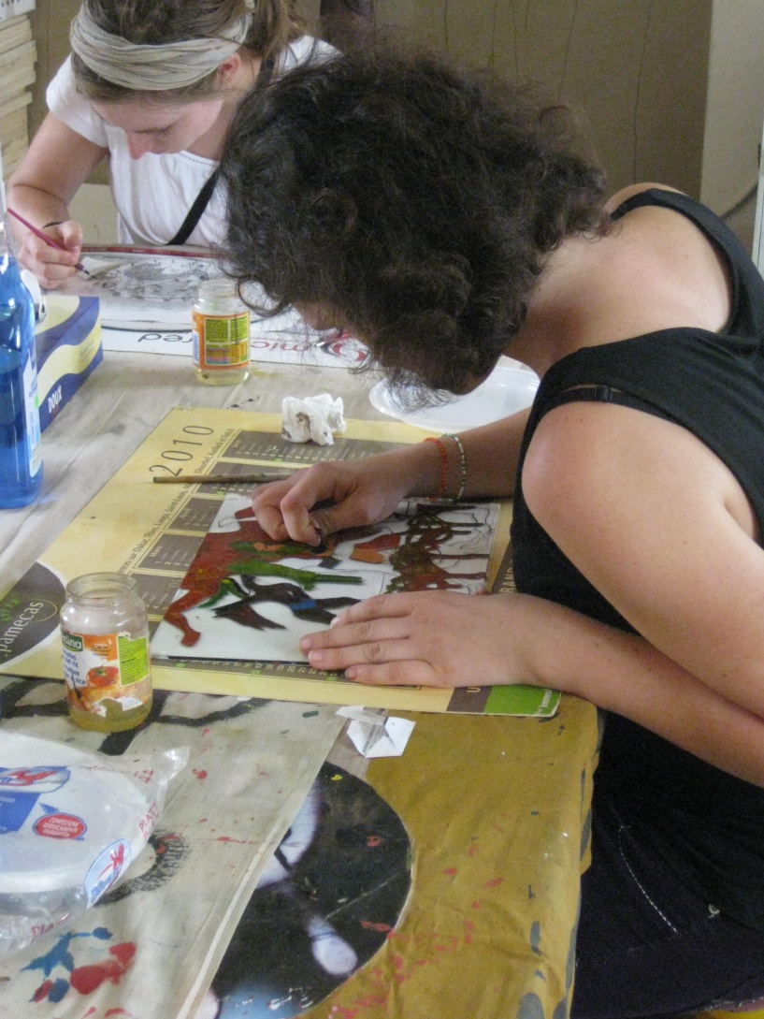
Visual Arts workshops
Students choose options:
Ceramics/pottery
Bronze sculpture
Glass Painting
Batik
Notes:
If the group size allows, everyone does batik in addition to their choice of ceramics, bronze, or glass painting.

Slide 13
Ceramics
“We were pretty much allowed to make whatever we wanted however we wanted. It was relaxing and interesting.”

Slide 14
Bronze sculpture
“A perfect reflection of experiential learning. I really enjoyed it.”

Slide 15
Glass Painting
“Séa showed us the basics, but then left us to our own imagination. He was very interested in what we were trying to portray. It was like a real exchange.”

Slide 16
Batik
“I loved the batik! They did a really great job of explaining the process and helping us along the way.”

Slide 17
Cultural practices workshops
Cooking cëbujën
Preparing natural juices
Buying fabric and having clothes made at the tailor
Senegalese values and beliefs
Notes:
These workshops are facilitated by the language instructors and focus on equipping students with practical knowledge, vocabulary and skills related to Senegalese cuisine, dress, and cultural values. They help students to understand, to appreciate and to succeed at carrying out “normal” everyday Senegalese activities.

Slide 18
Cooking cëbujën
“After the workshop where we made cëbujën with the profs, I felt more comfortable making it at home with my sisters.”
“Learning the cëbujën song was fun and made me realize how central this dish is to the culture.”
Notes:
These workshops are infused with cultural information and humor. E.g. the cebujen song that warns the cook’s husband will leave her if the cebujen isn’t good enough

Slide 19
Preparing local juices
“Now I can make bouye and bissap for my family in the USA.”

Slide 20
“Eating cëbujën around the bowl with the profs is one of the things I remember most from orientation.”

Slide 21
Understanding rural life
Harvesting fonio
Notes:
Focusing on the creation, that is, what you are making (a clay pot, a glass painting, bissap juice, or harvesting fonio) takes the focus off one’s self. Students become less self-conscious and some of the personal psychological barriers that hinder culture learning are minimized.

Slide 22
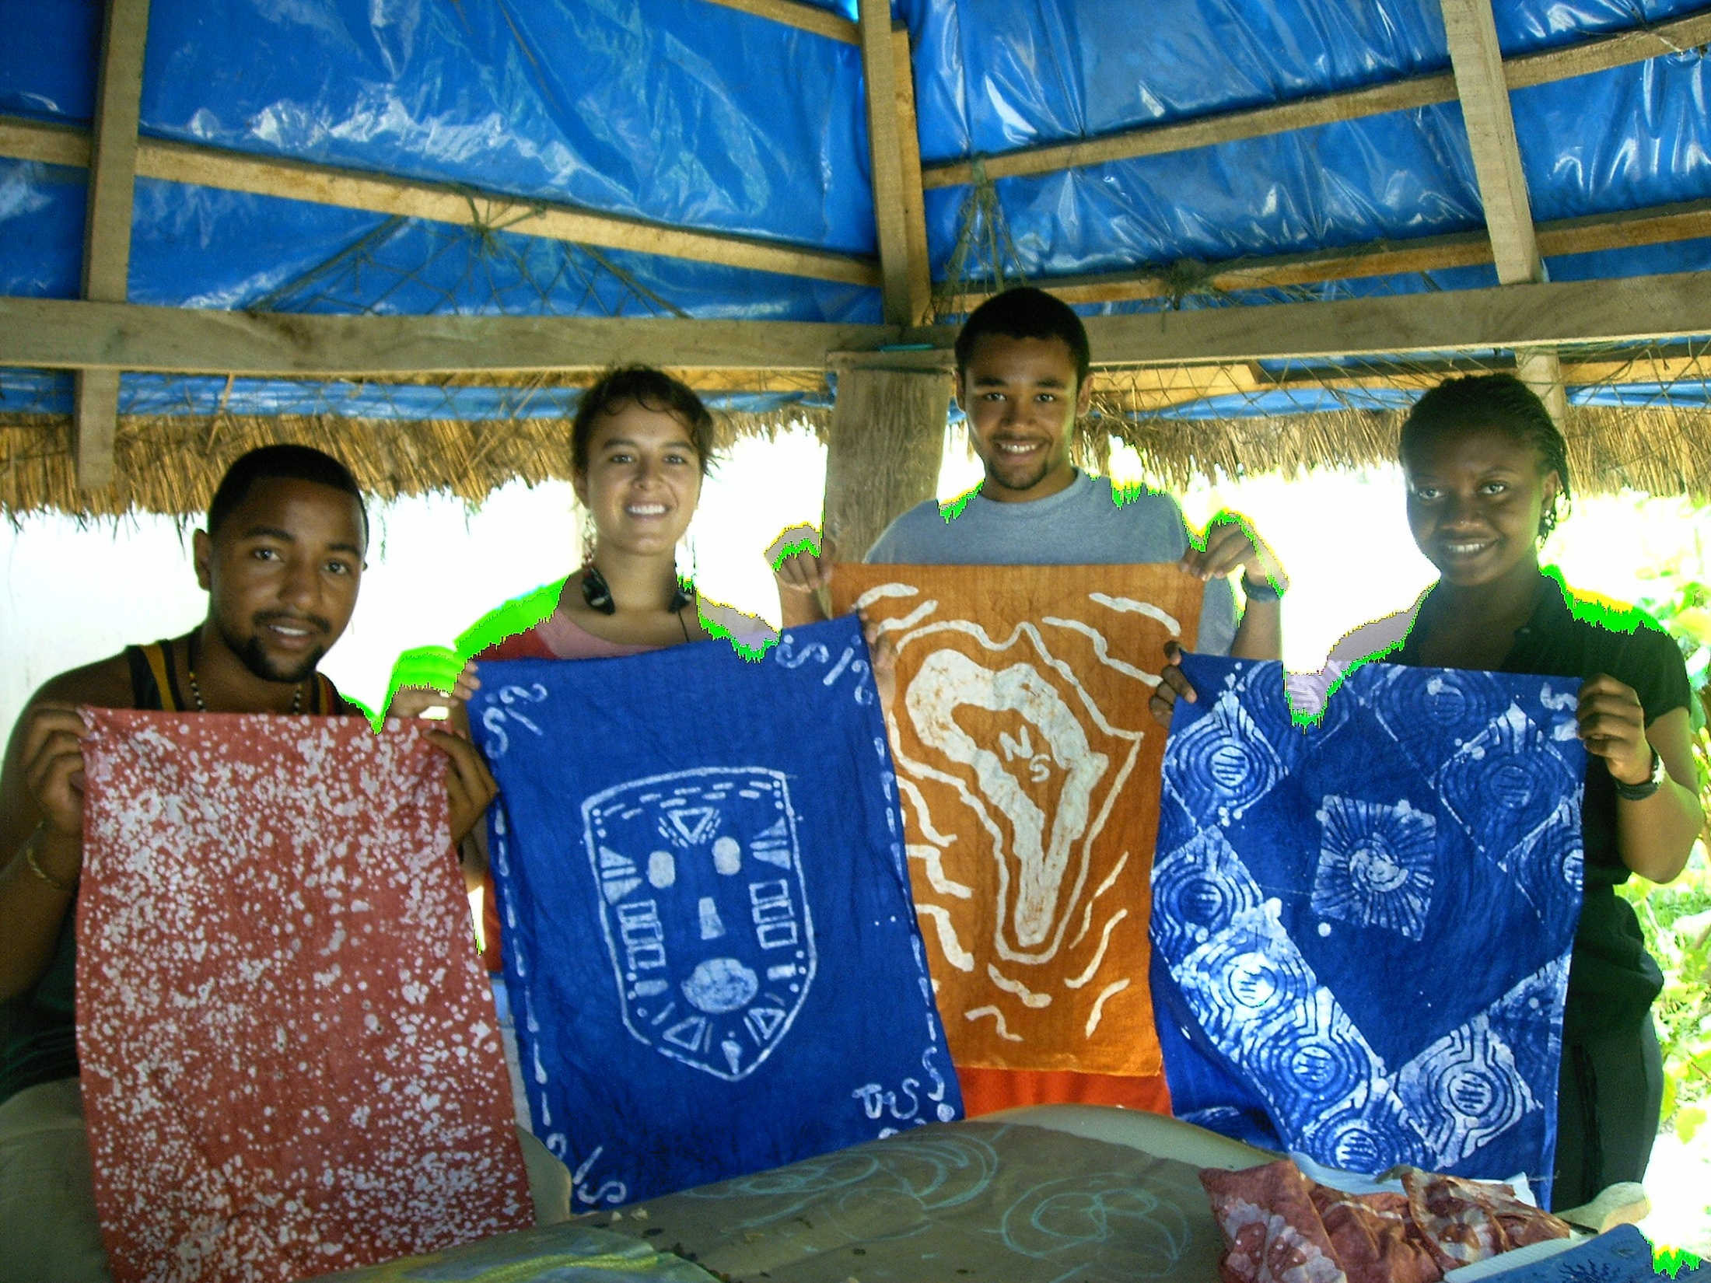
Learning culture through art
While participating in various hands-on workshops students learn arts that can be immediately applied and shared with their friends, family and community.
Being able to share and apply it immediately helps to master the art form more quickly.
They learn how fundamental values such as hospitality (teranga), sharing (mbokk), patience (jom) and self-integrity (fayda) play essential roles in Senegalese culture.

Slide 23
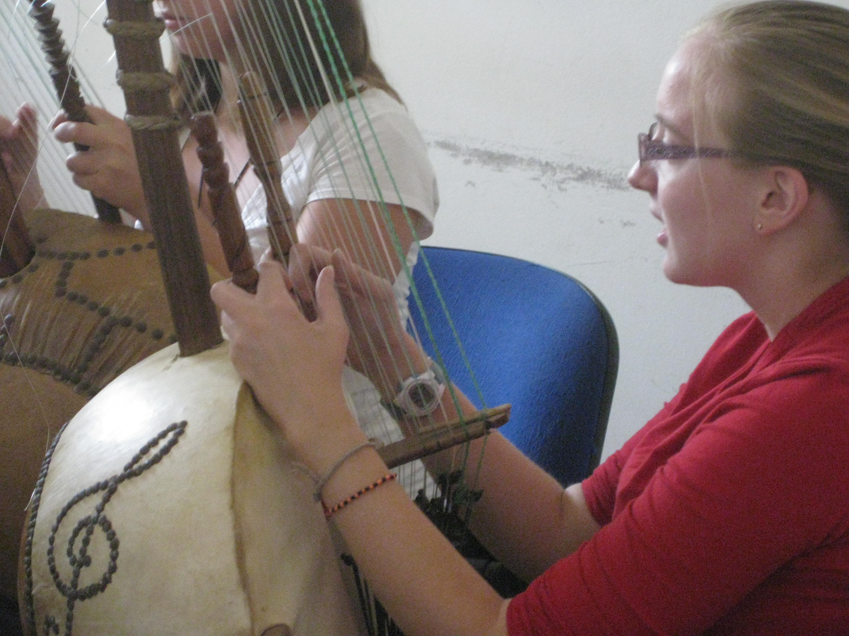
Growth as an individual and cultural learner
Students build confidence as they explore new ways to express their creativity
They step out of their comfort zones and try different learning styles based on imitation and repetition
They can apply what they learn in the fine arts to other areas such as language
Gain a new appreciation for patience and careful observation
Can laugh at themselves and foster a good sense of humor
Find it liberating: once they master the skill, they have the freedom to let it go!
Notes:
Students in this process gain respect from their Senegalese teachers and colleagues. They feel more integrated into the community and become more mature and confident.

Slide 24
“Fine arts are that in which the hand, the head, and the heart of man go together.”
--John Ruskin

Slide 25
Thank you! Let us enjoy a few Kora and Djembe notes

