Slide 1
Languages Lost and Found
Languages Lost and Found
A new role for language educators
Beverley Burkett, Elka Todeva & Leslie Turpin

Slide 2
The context for this presentation
Growing concern about the loss of the world’s linguistic diversity and the connection between language loss, culture loss, and environmental degradation
This has been linked to the effects of globalization and the spread of English as a lingua franca
This has led to two views of the teaching of English, and therefore of teachers of English (agents of imperialism + English as a skill/development
We propose a third – English for access and teachers as advocates and interlinguists

Slide 3
Some facts
50% of the world’s 6,000-7,000 languages will be lost in this century
One language will be lost about every two weeks (Grenoble and Whaley, 2006)
90% of Australia’s 250 languages are on the verge of extinction (Nettle and Romaine, 2000)
155 of the 175 Native American languages are no longer spoken or remembered

Slide 4
More facts…..
There is a correlation between biodiversity and linguistic diversity (Biolinguistic Diversity).
The greatest biolinguistic diversity is found in areas inhabited by indigenous peoples who represent around 4 percent of the population but speak about 60% of the world’s languages and manage many of the ecosystems richest in biodiversity (Nettle and Romaine 2000) .

Slide 5
Article 5 of UNESCO’s declaration on cultural diversity states:
All persons should therefore be able to express themselves and to create and disseminate their work in the language of their choice, and particularly in their mother tongue; all persons should be entitled to quality education and training that fully respect their cultural identity (Grenoble and Whaley, 2006. p.2)
fewer than 500 languages are used and taught in education

Slide 6
Importance of language use at home
Although control over language of the workplace, government, and education may be ultimate goals of language revival and maintenance efforts, they should not be the first priorities. Without safeguards for language use at home sufficient to ensure transmission, attempts to prop the language up outside the home will be like blowing air into a punctured tire. It will be impossible to achieve a steady state based on the incoming air due to the continual losses resulting from the unmended puncture.
(Nettle and Romaine, 2000.p. 178)

Slide 7
Definitions of stages of language loss
SAFE | All generations use the language in all or most domains Large speaker base in relation to other languages spoken in the region Typically language of government, commerce and education
AT RISK | Used in fewer domains Smaller numbers of speakers than other languages in the region

Slide 8
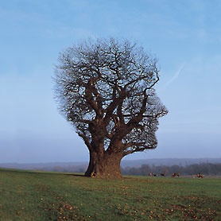
DISAPPEARING | There is an observable shift towards another language in the communities where it is spoken There is a decrease in intergenerational transfer The language of wider communication replaces the language in all but restricted domains
MORIBUND | A language that is not transmitted to children
NEARLY EXTINCT | handful of oldest generation of speakers of the language remain
EXTINCT | No remaining speakers

Slide 9
What gradual language death looks like
Language atrophy - reduced numbers of domains
Loss of language related to disappearing contexts (i.e. if the context for storytelling disappears, the language for storytelling and the stories disappear)
Diminished vocabulary and base words from which to create new words
Lack of coinage of new words
Increased reliance on formulaic expressions and routine speech—lack of spontaneous conversation

Slide 10
Loss of specific words, replaced by general words
Loss of names referring to culture-specific items relating to weather, geography, ceremonies and kinship terms (and the kinship system and structure that they represent)
Increased borrowing of English words
Absence of complex language structures that would normally be learned if a younger person were to reach maturity speaking/writing the language
(From Nettle and Romaine, 2000)

Slide 11
Absolute Number of Speakers
Intergenerational Transmission
Community members’ attitudes toward their own language
Amount and quality of documentation
Language vitality
Trends in existing language domains
Proportion of speakers within the total population
Materials for language education and literacy
Governmental and institutional language policies, including official status and use
Response to new domains and media
(From UNESCO’s ad hoc group on Endangered languages 2003 in Grenoble and Whaley, 2006, p. 4)

Slide 12
What can we do as language educators?
In the community:
Create awareness of other languages
Understand the dynamics and domains of language use of the communities in which we work
Act as language advocates
Produce material in local languages

Slide 13
What we can do in the classroom
adopt plurilinguistic pedagogy
Undertake language research with students

Slide 14
Learners as ethnographers and plurilinguistic pedagogy
lexicon /phraseology
pragmatics
grammar
pronunciation
spelling
writing (in terms of rhetorical organization)
The idea is to respect students as knowers

Slide 15
Bring the community and the languages into the classroom
as multilingual resources
use language for academic purposes to increase status
create materials and opportunities for community-classroom exchange

Slide 16
The South African example: We had story tellers come to school

Slide 17
Learners wrote their favorite stories, illustrated them and made books

Slide 18
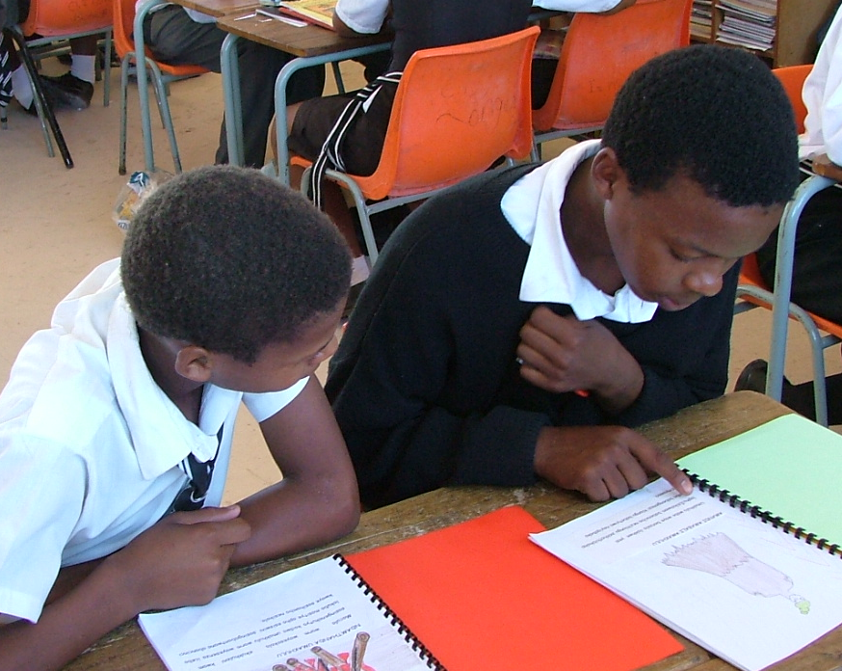
They read the books they made

Slide 19
Older learners read to younger ones

Slide 20
Workshops were held to promote family literacy

Slide 21
The women were proud of their writing

Slide 22
What could (should) World Learning’s role be?

Slide 23
How does your language rate?
A | spoken by all generations
A- | learned by most but not all children
B | spoken by all adults parental age and up but not learned by children
B- | spoken by adults who are 30 and older but not by younger parents
C | spoken by adults in their 40s and up
C-D | all speakers are in their 50s and up and 60s and up
D | all speakers are in their 70s and older
D- | all speakers are in their 70s and older and there are 10 speakers at most
E | EXTINCT

