Slide 1
Code Green:
Using the Participatory Approach to grow Environmental Awareness
Please look at the books

Slide 2
ParticipantsWBAT
By the end of the presentation, the participants will know how to structure a lesson using the participatory approach
Other environmental activities to use in the classroom will be emailed and posted on web
~ Please sign your name and email ~

Slide 3
My reasoning
Environmental club member in undergrad
Green Team member past years
Organized “Climate Change” presentation
Students as passive containers
The recycling bin in my classroom

Slide 4
Participatory Main Points
Acquisition requires meaningful interaction
Paulo Freire
Students are resources - class content
Critical skills to advocate for self within community through action task
Setting the tone of the class – Elsa Auerbach
Social questions discussed thru a code

Slide 5
Code Resource:
Energy and Environment
“Clinton-Era Rule Protecting Forests Upheld”
Friday, August 7, 2009

Slide 6
A national park is a reserve of land protected by a national government from major development.
A national forest is used for timber harvesting, livestock grazing, water, wildlife, and recreation

Slide 8
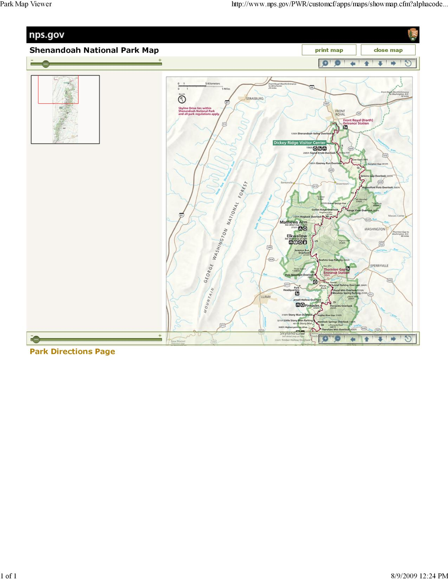

Slide 9
Maggie: “I went hiking in the wilderness and I crossed like 5 roads. I thought there weren’t supposed to be any roads.”
Mike: “Building roads makes jobs and so does logging. Anyways, trees are renewable resources.”
Daniel: “I know logging creates jobs but clear cutting discourages hiking and hunting. With sustainable logging, you have the best of both worlds.”
Maggie: “I’m pissed that my taxpayer’s dollars are going to subsidize road building and logging on public lands.”
Gail: “Yeah, these are our public lands to conserve our ecosystems, there’s plenty of logging allowed on private lands.”
Mike: “Regardless, roads are needed to get into the forest to do your hiking or logging.”
Maggie: “There are tons of roads in national parks. Try hiking in to a crystal clear river to go fishing, you lazy bums.”

Slide 10
Define the Problem
What is the problem?
What are the different perspectives of the problem?

Slide 11
Personalize the Problem
How do you connect to this situation?
Are you a hiker, know a logger?

Slide 12
Analysis
Are there any common themes?
What are the roots/ causes/ consequences of the situation?

Slide 13
Critical Action
What are the next steps?
Given constraints, what can we do?

Slide 14
Addressing Missing Aspects
Teacher observes for language feedback
meaning, use and form follow up work

Slide 15
Feedback
Be honest:
How was this process?

Slide 16
Resources to explore Environmental Awareness in YOUR class!
http://www.earthday.org/footprint/
Teach English, Teach about the Environment
http://www.epa.gov/epawaste/education/pdfs/tesol.pdf

Slide 17
Extra time? Parks in your state!
http://www.nps.gov/findapark/index.htm
~~~~~~~~~~~~~~~~~~~~~~~~~~~~~~~~
THANK YOU FOR COMING!!!
~~~~~~~~~~~~~~~~~~~~~~~~~~~~~~~~
I will email you the powerpoint, my lesson plans, and suggested texts, also posted at:
http://digitalcollections.sit.edu

