Slide 1
Cooperation and collaboration
Interactive ways of learning

Slide 2
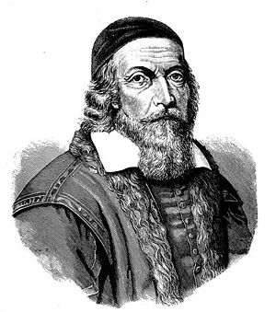
If necessary, deprive yourself of something else, but pay somebody who will listen to you.
(Ján Amos Komenský 1592 - 1670).

Slide 3
A collective way of learning
is a system of cooperation among students that allows teachers to structure the material in accordance to :
Students capabilities;
Individual pace of learning;
Students’ individual zones of proximal development.

Slide 4
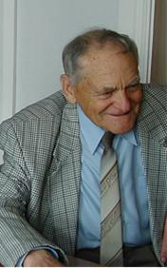
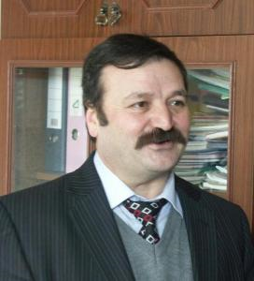
Andrew bell, Joseph Lancaster
Monitorial system of education
(19 century)
Maria Montessori (1870-1952 )
Ludmila Volshteyn
Vitaliy Dyachenko 1923-2008
Manuk Mkrtchyan
A. G. Rivin
30- 40^{s} , 20th century

Slide 5
Two types of cooperation organization
Horizontal – cooperation among students about the same or equally complex and topic related content;
Vertical - cooperation among students about varied and level ranged content.

Slide 6
Principles of the Collective Way of Learning
Inclusion
Accomplishment
Cooperation
Success

Slide 7
Groups of Interactive techniques and activities
Sharing information technique
A boat trip around Krasnoyarsk (a content based speaking activity)
Exchanging tasks technique
Answer key activities
Mutual instruction technique
Carousel activity (a rapid changing of partners)
Decoding activity
Ship battle activity

Slide 8
Questioning a lot, internalizing and teaching others are the secrets of the greatest intelligence.
(Ján Amos Komenský).

