Slide 1
Family English learning: A workshop on using English at home
Wednesday, 10:30 AM
Auditorium
Paper/Workshop
By James Johnston
SIT Graduate Institute
MAT 45, 2013-2014

Slide 2
Summary of presentation
This presentation examines how EFL teachers can integrate their students’ mothers and communities into their classrooms using a family-oriented approach
Topics that will be discussed:
Mothers and their roles in the classroom
Overview of my research on Korean education and family literacy programs
Examination of effective family learning programs
Brainstorming session on using family learning targeted at mothers in your classrooms

Slide 3
The importance of mothers
The crux of this paper revolves around the archetypal idea of mother as “teacher”
Activity: On the whiteboard, write two or three words that relate to your idea of “mother as teacher”

Slide 4
Mother-teacher relationships
In many educational situations, mothers interact with a teacher
Discussion: Here are some questions to think about:
What interactions have you had with your students’ mothers?
How could you have worked better with those mothers?
How could you have involved them more in your students’ education?

Slide 5
Mother-teacher, cont.
Activity: Divide into two teams, and on half of the butcher paper, write down your answers to the following questions:
Group 1: How do mothers aid in learning within the teacher-student relationship?
Group 2: How do mothers aid in learning outside of the classroom?

Slide 6
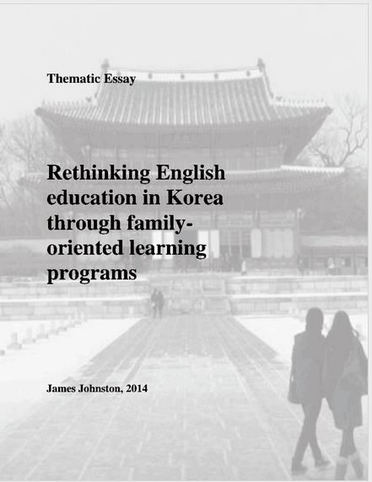
Rethinking education in Korea
In my thematic essay, I looked at two things:
The sociopolitical and cultural challenges that Korean learners face
The possibilities of integrating family-oriented language learning programs in South Korea

Slide 7
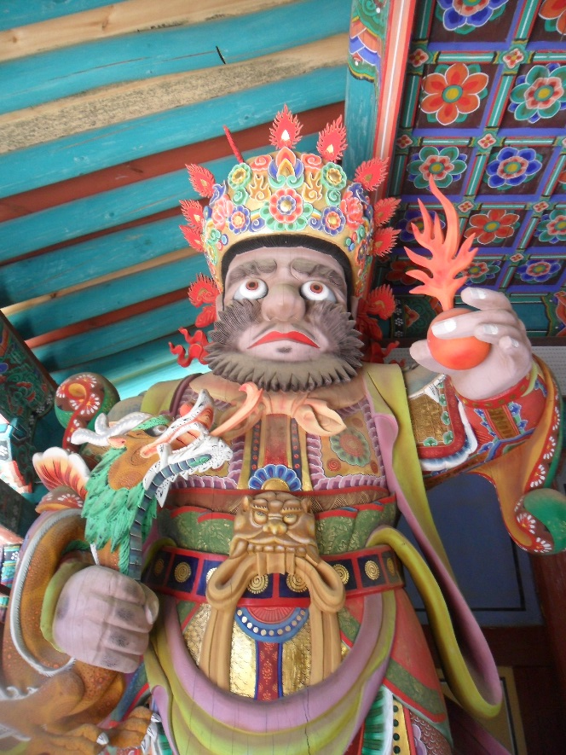
Mothers in South Korea
Mothers’ take education very seriously
They are nicknamed, “Tiger moms”
They helped make Korea one of the best educated countries in the world:
6th best educated country in the world with 7.6% of its GDP being spent on education (Grossman, 2012; ICEF Monitor, 2014)
English education market being worth approximately 4 trillion Korean Won (KRW), roughly $3,333 million (Cho, 2004, p. 646)

Slide 8
Background on education in Korea
Where does this “English craze” come from?
1950s, America’s influence during and after Korean War
1987 Standardized tests
1990s, Korea entering globalized market
1997, students start English in 3rd grade (as opposed to 7th grade)
2000, government passes laws, where mothers have more choice over their children’s education

Slide 9
The problematic nature of English in Korea
With the importance of test scores, families pushed children to study
Hagwons (‘cram schools’) began to spring up by 10s of 1,000s
English seen as class marker in Korean society (Cho, 2004; Park & Abelmann, 2004)

Slide 10
Divide between rich and poor
The rich can pay for:
The poor can pay for:
?
Expensive hagwons
Private in-home tutors
Moving to an English speaking country (“Goose families”)

Slide 11
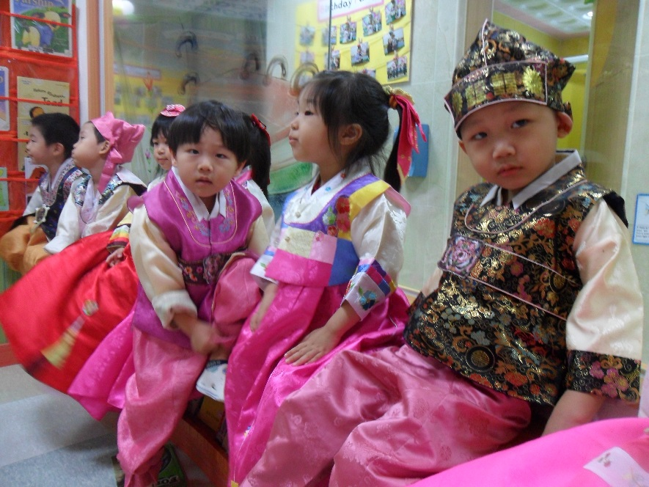
More and more competitive
Children, 3 and 4 years old study 6 hours a day
High school students, 8-10 hours a day
This stress has been tied to Korea’s high rates of suicide – one of the top 3 in the world (Sistek, 2013; OECD, 2013)

Slide 12
Lows results on investments
Disconnection between how much Koreans spend on education and how well Korean students can speak English
24th on the World’s English Language Proficiency Index (English First, 2014)
110th on ETS's global TOEFL rankings (Card, 2006)
Some argue that this is because of cultural differences
Western versus Asian speaking styles
Activity: Talk with your partner about how Korean culture or any cultural norm you know of might hinder of inhibit learning English.

Slide 13
My beliefs
English should be seen not seen as a topic in isolation, but a living, breathing, evolving thing

Slide 14
Possible societal solutions
Integrate English language learning into the community
Families, friends, and communities play an important role in language learning (Williams & Burden, 1997)
Teach ideas of self reflection on the part of the student
Language learning involves adapting new social and cultural behaviors (Williams & Burden, 1997)
Encourage safety and self-esteem in the class
This encourages the lowering of the affective filter

Slide 15
Family learning models
What is family literacy?
Activity: Talk with a partner about what a family literacy program involves & look at the picture for ideas

Slide 16
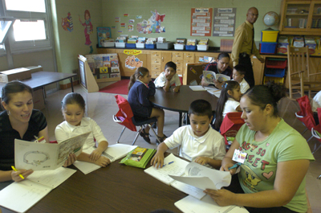
What do you see in the picture?
Photo taken from http://www.swsol.org/articles/NCFL_study2009

Slide 17
Differences between “literacy” and “learning”
“Family literacy” programs tend to focus on parents with low literacy, either from low economic backgrounds or immigrants
Teach language skills, e.g. reading, writing, etc.
Focus on life skills, i.e. banking, shopping, reading, and parenting skills
My definition of “family learning” is different.
Instead of limiting “family” to students with low literacy, “family learning” can be applied to students, who are educated and speak English as a second for foreign language

Slide 18
Elements of a successful family-learning model
Community partnership (Knaflic, 2005)
Involvement from both mother and child
Have activities the learners enjoy and have ownership over (Williams & Burden, 1997)
Have activities that are relevant and meet the needs of the mothers’ and children’s lives (Graves, 1996)
Family learning can involve a number of different approaches:
Competency-based, Freirian, Community Language Learning, etc.

Slide 19
Looking at your contexts
Think for a moment about this idea:
All of you will go to a community and teach.
What can you do to encourage family learning in your context?

Slide 20
Activity: Developing a family-learning project for your context
Find a partner with a similar context/part of the world
Brainstorm a one-day lesson you can use in your classroom that involves your students’ parents/children, their families, and maybe even their community
The lesson can be outlined briefly but should show the steps you’d do in your class
Write your final lesson on a piece of butcher paper and hang it on the wall
Then, all of the students will look at each other’s ideas

Slide 21
Follow-up: Gallery Walk
What ideas were strong?
What ideas can you take to your context?
What are some advantages of family learning programs?
What are some disadvantages?
How did your first ideas about mothers in the classroom relate to your lesson plan?
Other questions?
Clip art taken from http://www.mrsjrees.com/1/post/2014/02/cold-war-gallery-walk.html

Slide 22
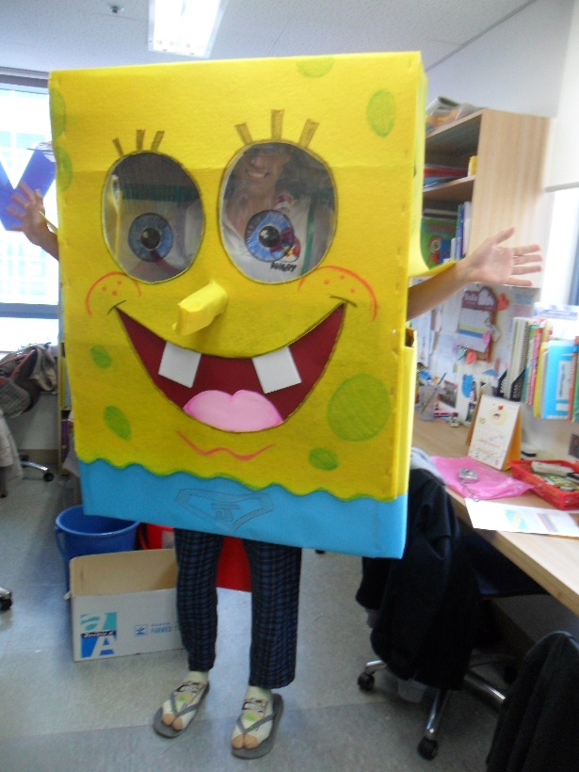
Thank you
Please provide feedback on the forms provided

