Slide 1
Advanced EAL class; relative clauses
May 19, 2014
Sandanona Conference
Jihyun Sung
Notes:
Let’s start with some cartoons ☺

Slide 2
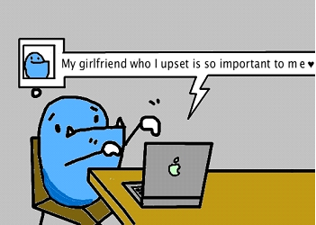
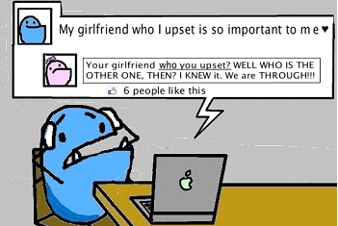

Slide 3
Agenda
Warm-up 1) Limiting the topic
2) What are they? How to form them?
Form/meaning/use + Core/peripheral
Suggested grammaring activities
Notes:
We are going to spend more time for F/M/U+C/P and grammaring activities.

Slide 4
Limiting the topic
Restricted relative pronoun clauses
The letter that he sent was never received.
A person who sells houses is a realtor.
Restricted relative adverb clauses
That’s the hotel where I was stayed.
Non-restricted relative pronoun clauses
My sister, who lives in Canada, is a biologist.
Non-restricted relative adverb clauses
John F. Kennedy was assassinated in 1963, when Anne was studying a Kansas State University.
Notes:
Restricted/Non-restricted relative pronoun/adverb clauses

Slide 5
What are they?
Relative clauses are clauses modify noun phrases (NP).
How to form them?
I like the girl.
The girl has a boyfriend.
who/that
has a boyfriend.
I like the girl
I like the girl.
The girl has a boyfriend.
The girl has a boyfriend.
who(m)/that
I like

Slide 6
How many different restricted relative clauses in English?
Effect 40 distinct relative clauses
There are more out there!
(deleting, extra-posing, non-restricted relative clauses, relative adverb clauses, etc…. )
Teacher’s choice is important!
(Pedagogical grammar)
Notes:
effect 40 distinct relative clauses
deleting, extra-posing, non-restricted, relative adverb clauses, etc. 합하면 so many! Choice is important! Pedagogy grammar!
여기까지 10분 소요. 1시 40분쯤

Slide 7
F/M/U + Core/peripheral
* RRPCs: Restricted relative pronoun clauses
Core
???
Peripheral
Meaning
Form
Use
Timer
Notes:
1시 45분 시작!

Slide 8
Restricted relative pronoun clauses Go-ROUND
Station 1 Taboo cards
Station 2 Who Do They Love?
Station 3 Describing Inventions
Notes:
2시 시작! 15분…

Slide 9
References
Feedback on color paper ☺
On one side, write down your takeaway from this
presentation. On the other side, some suggestions, please.
Celce-Murcia, M., Larsen-Freeman, D., & Williams, H. A. (1999). The grammar book :An ESLEFL teacher's course (2nd ed.). Boston: Heinle & Heinle.
Cowan, R. (2008). The teacher's grammar of english :A course book and reference guide. Cambridge: Cambridge University Press.
Larsen-Freeman, D. (1997). Grammar dimensions :Form, meaning, and use (2nd ed.). Pacific Grove: Heinle & Heinle Publishers.
Notes:
5분… 2시 10분쯤 시작

